Slide 1
Importance of food microbiology unit 3 biosafety

Slide 2
definition
Food microbiology is a branch of microbiology that deals with microorganisms present in food, their interactions, and their impact on food quality, safety, and shelf life.

Slide 3
general principles of food microbiology
1.Microbial Growth: Microorganisms require specific conditions to grow and reproduce, including nutrients, pH, temperature, and water activity (aw). Understanding these factors helps in controlling microbial growth in food.
2.Types of Microorganisms: Common types of microorganisms in food include bacteria, yeasts, molds, and viruses. Each has different growth requirements and impacts food differently.
3. Spoilage: Microorganisms can cause food spoilage through various mechanisms, including production of enzymes, acids, and toxins, leading to changes in taste, texture, and appearance.

Slide 4
general principles of food microbiology
1.Microbial Growth: Microorganisms require specific conditions to grow and reproduce, including nutrients, pH, temperature, and water activity (aw). Understanding these factors helps in controlling microbial growth in food.
2.Types of Microorganisms: Common types of microorganisms in food include bacteria, yeasts, molds, and viruses. Each has different growth requirements and impacts food differently.
3. Spoilage: Microorganisms can cause food spoilage through various mechanisms, including production of enzymes, acids, and toxins, leading to changes in taste, texture, and appearance.

Slide 5
general principles of food microbiology
4. Food Safety: Some microorganisms can cause foodborne illnesses (food poisoning) by producing toxins or by infecting the consumer. Pathogenic bacteria like Salmonella, Listeria, and E. coli are significant concerns.
5. Food Preservation: Techniques such as heat processing (e.g., pasteurization, sterilization), refrigeration, freezing, drying, fermentation, and use of preservatives are used to control microbial growth and extend shelf life.
6. HACCP (Hazard Analysis Critical Control Points): A systematic preventive approach to food safety that identifies, evaluates, and controls hazards throughout the food production process.

Slide 6
general principles of food microbiology
7. Quality Control: Microbiological testing and monitoring are essential for ensuring food safety and quality. This includes testing for pathogens, spoilage organisms, and indicators of hygiene and cleanliness.
8. Regulatory Standards: Food microbiology is guided by national and international regulations and standards that specify acceptable levels of microorganisms, hygiene practices, and safety measures in food production and handling.
9. Emerging Issues: Changes in food production practices, global food trade, and consumer preferences continuously influence food microbiology. Issues such as antimicrobial resistance and novel food technologies are also areas of concern.
10. Education and Research: Ongoing research in food microbiology focuses on understanding microbial behavior, developing new preservation techniques, and improving food safety measures.

Slide 7
Why these principles?
Understanding these principles helps food scientists, producers, and regulators ensure that food is :
safe,
nutritious,
and of high quality
throughout its production,
distribution,
and consumption.

Slide 8
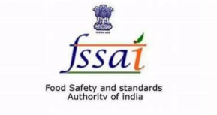
Unit 3

Slide 9
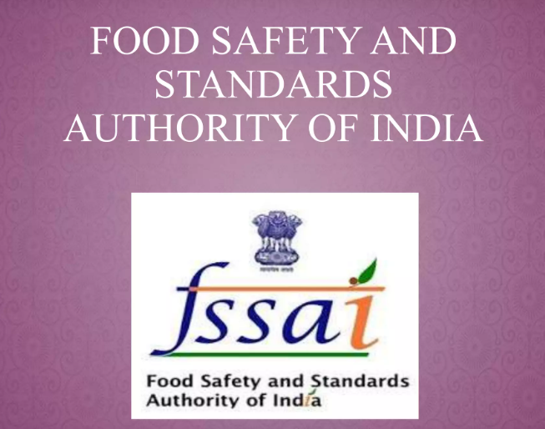

Slide 10
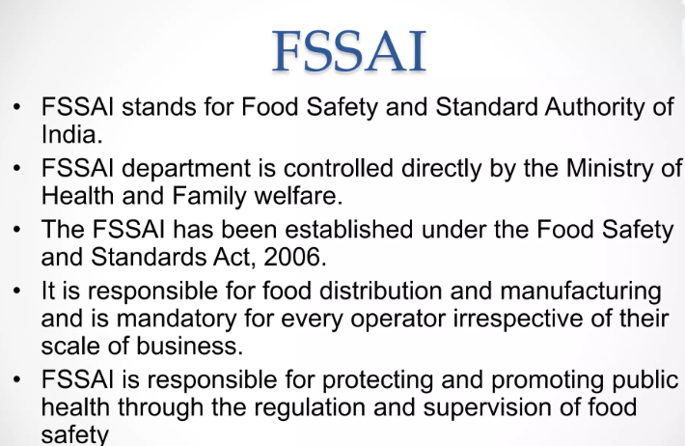

Slide 11
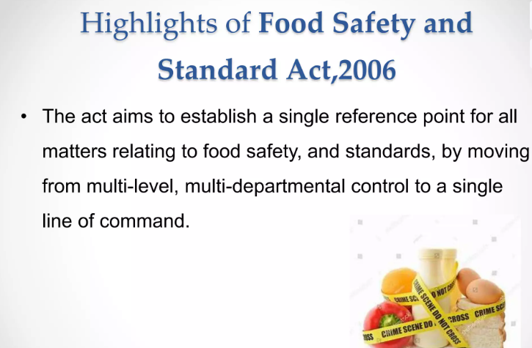

Slide 12
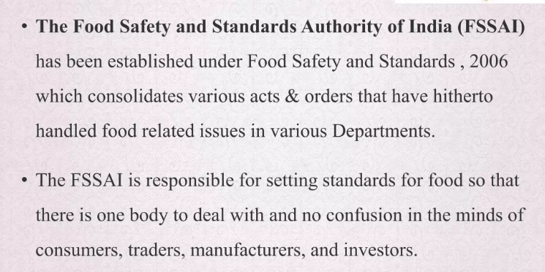

Slide 13
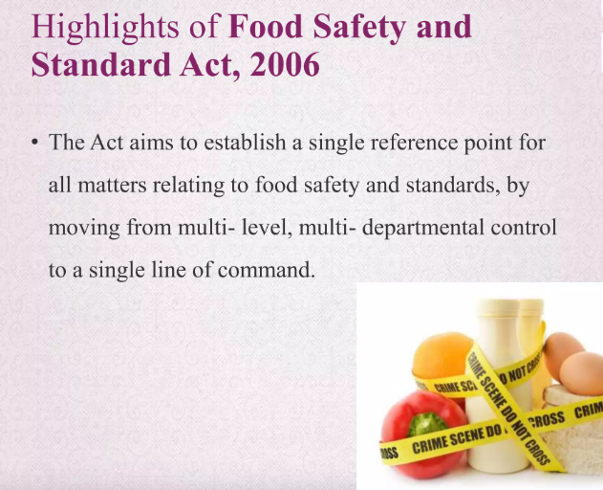

Slide 14
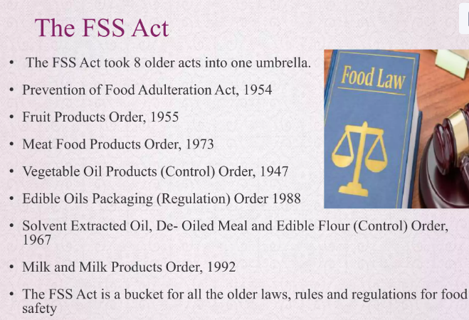

Slide 15
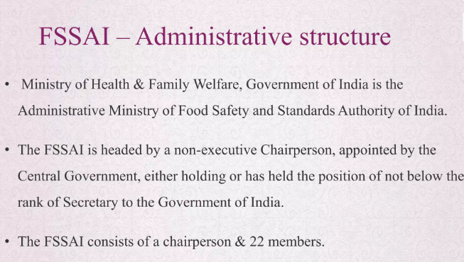
As of October 2024, Shri Sudhansh Pant is the Chairman of the Food Safety and Standards Authority of India (FSSAI). He is also the Secretary of the Ministry of Health and Family Welfare, Government of India

Slide 16
Appointment | The central government appoints the chairperson, who is a non-executive member. The chairperson must have held or currently hold the position of Secretary to the Government of India or higher.
Other members | The FSSAI also has 22 other members, including at least one-third women.
Headquarters | The FSSAI is headquartered in New Delhi.
Regional offices | The FSSAI has regional offices in Delhi, Guwahati, Mumbai, Kolkata, Cochin, and Chennai.
Laboratories | The FSSAI has 22 referral laboratories, 72 state/UT laboratories, and 112 NABL accredited private laboratories.
Enforcement | Food Safety Officers enforce FSSAI provisions.

Slide 17
The FSSAI is a statutory body established under the Food Safety and Standards Act, 2006. It's responsible for protecting and promoting public health through the regulation and supervision of food safety.

Slide 18
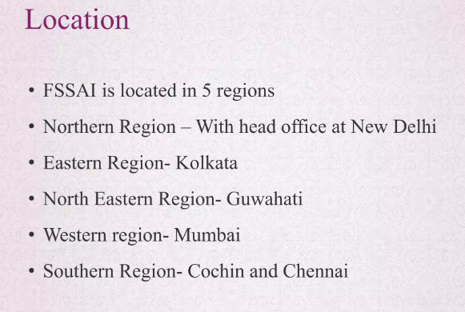

Slide 19
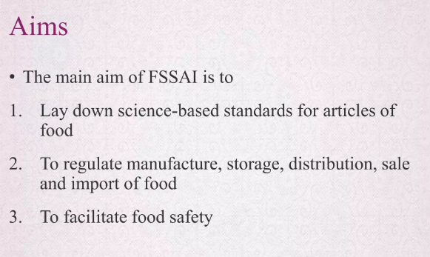

Slide 20
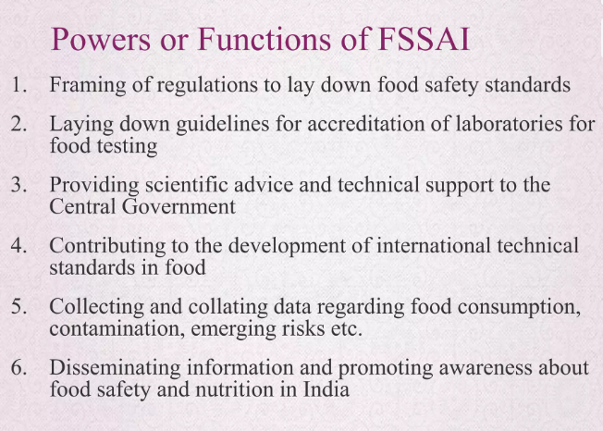

Slide 21
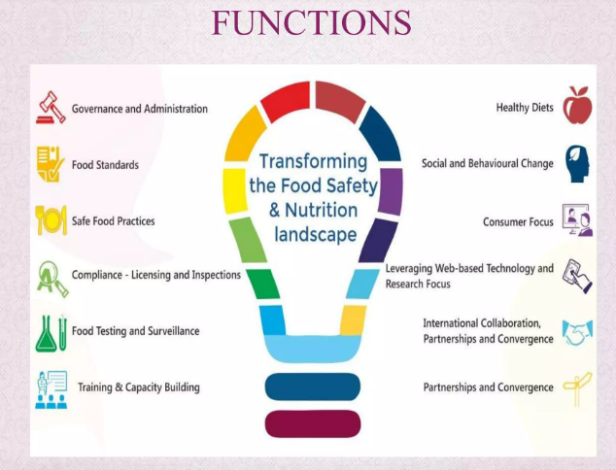

Slide 22
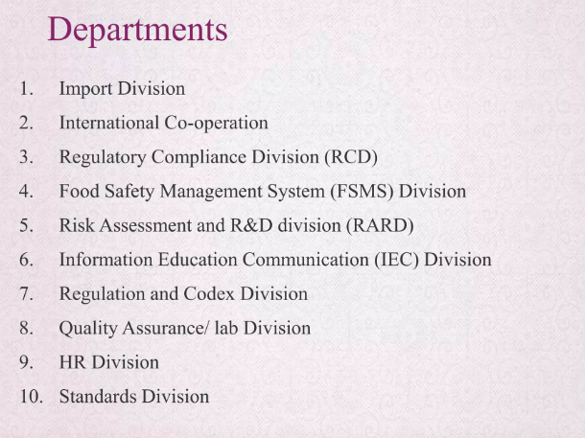

Slide 23
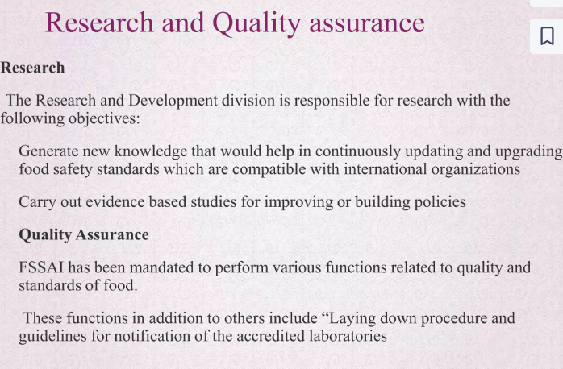

Slide 24
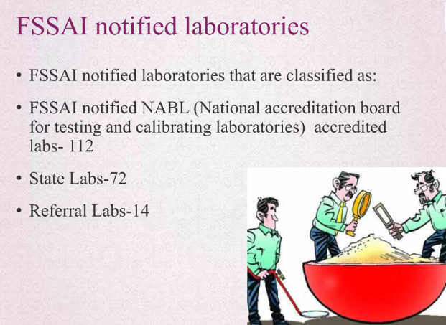

Slide 25
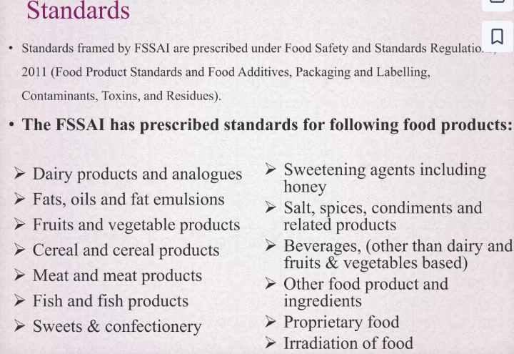

Slide 26
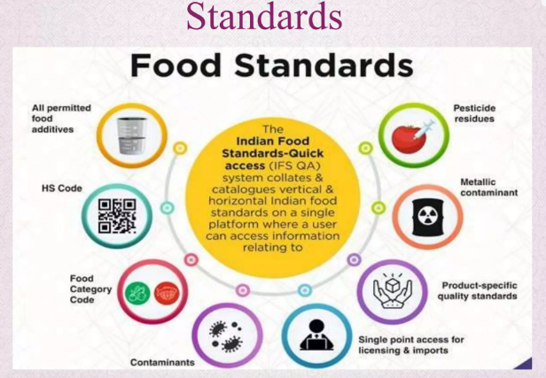

Slide 27
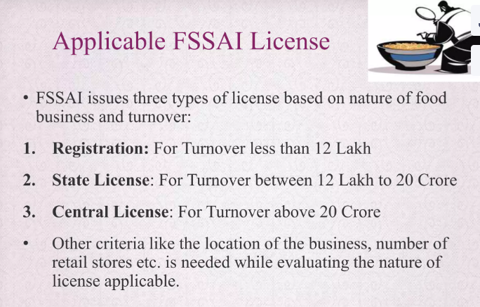

Slide 28
TYPES OF LICENSES
If you want to know How To Get FSSAI License in India, then you must know these three types of licenses.
Generally, FSSAI Registration or License is based on business volume and business establishment. Depending on different factors like Installed capacity, Turnover and Location the Applicants establishments can be eligible for three different Licenses.
Basic License: Basic License is issued by the State Government to the small (manufacturers, storage units, transporters, marketers, and distributors). This License is generally issued to a company with an annual yield of not more than Rs 12,00,000.
Note: This License is issued for a period of a minimum of 1 year and a maximum of 5 years.

Slide 29
State License: This License is generally issued for SMEs like Transporters, Storage Houses, Distributors, and Marketers, etc. The company involved in the food business must have its business operations in one state. The company should have an annual yield of Rs 12, 00,000.
Note: This License is issued by the state government for a minimum of 1 year and a maximum of 5 years.

Slide 30
Central License: This License is generally issued by the Central Government, to the food business operators operating in more than one state or city, companies operating as importers or exporters in food-related business, big manufacturers in the food and processed food-related business, food business operators working with central government agencies, ports, and airports, etc.
Note: If a company involved in food or food-related business (Nutrition Supplement) is operational in different states or cities then it is essential for its head office, to apply for a central License. Along with this Central License is mandatory for a Food Business operator having an annual yield of Rs 20 Crores.

Slide 31
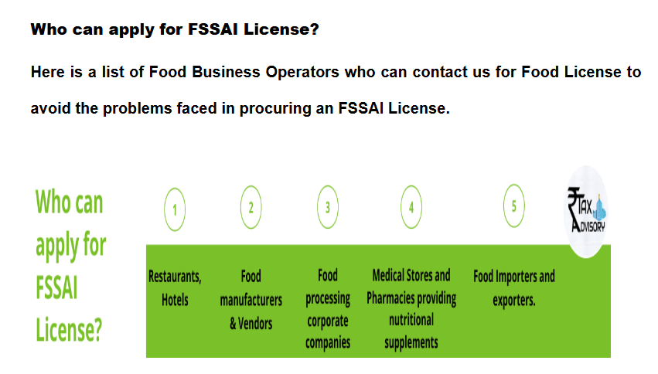

Slide 32
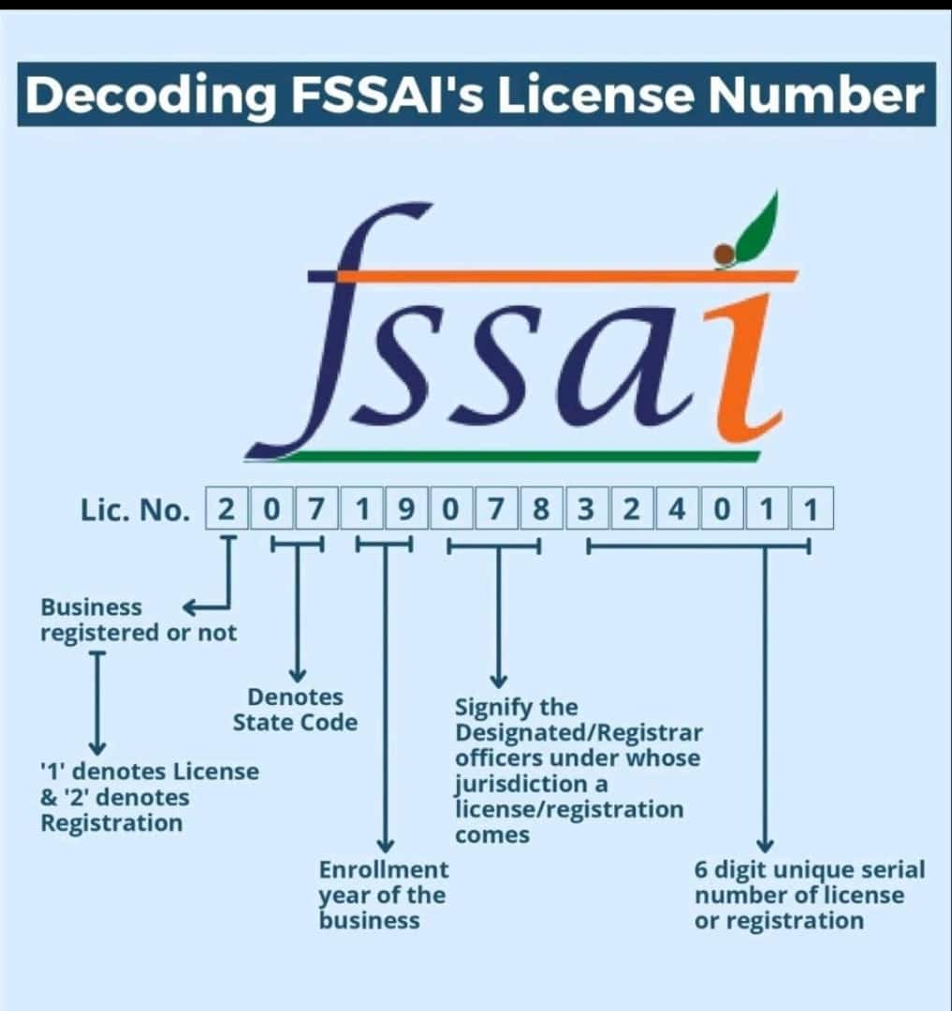
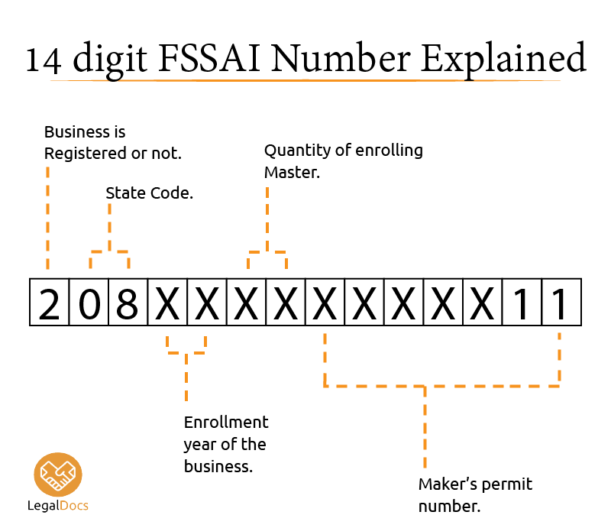

Slide 33

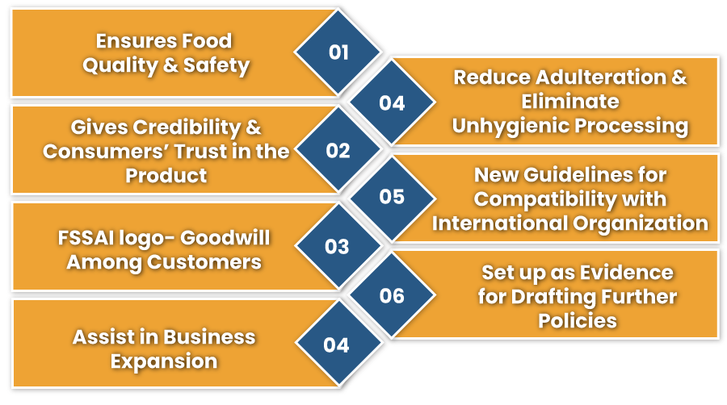

Slide 34
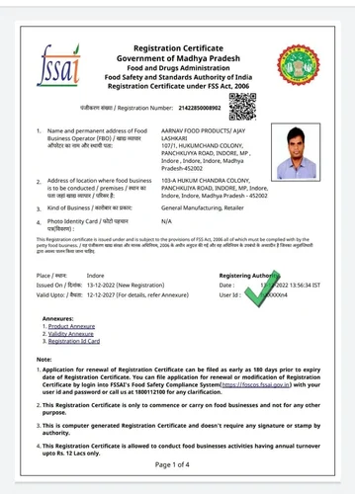
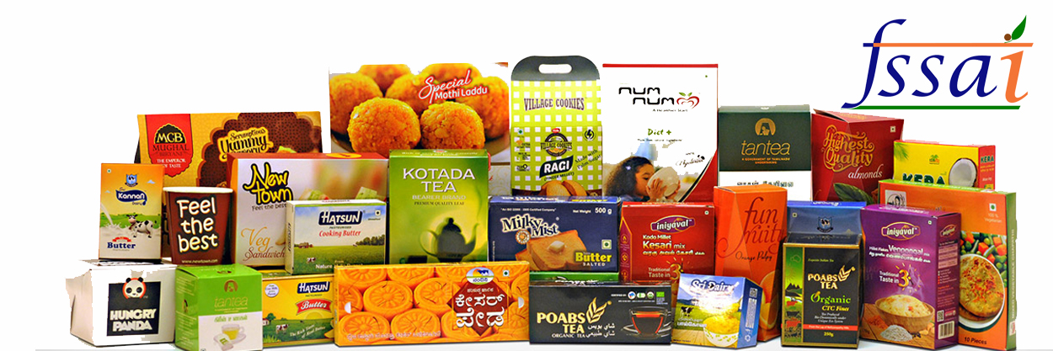
Sample FSSAI license

Slide 35
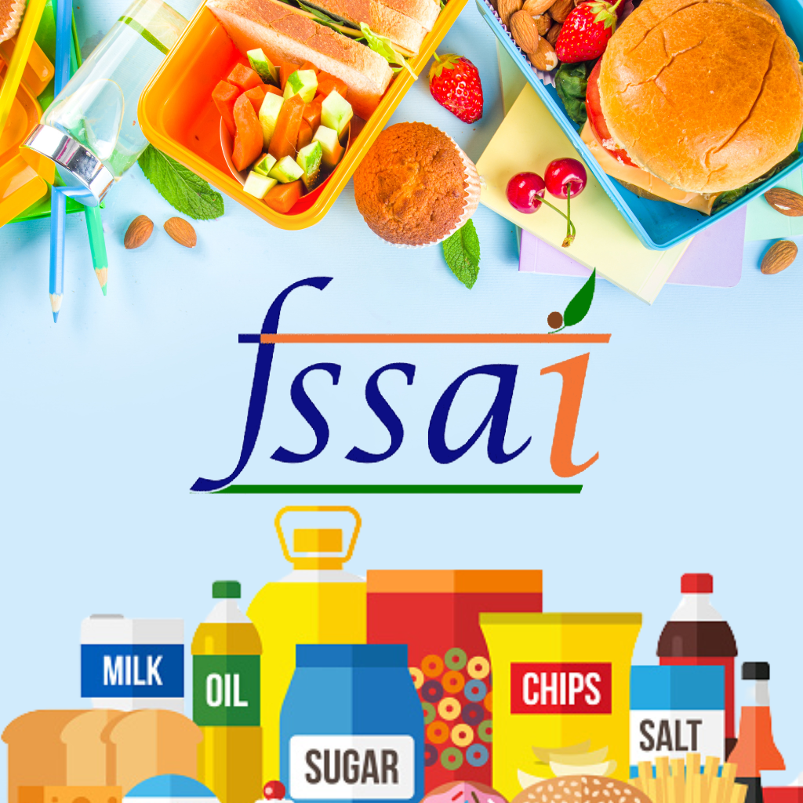
THANK YOU

